Slide 1
CS 4031 Compiler Construction
Faryal Saud
Lecturer, Department of Computer Science
FAST NUCES CFD

Slide 2
Semantic Analysis
Semantics of a language provide meaning to its constructs like tokens and syntax structure.
Semantic analysis judge whether the syntax structure constructed in the source program provide any meaning or not.
For Example:
Int a = “book”
is syntactically correct but generates a semantic error
Solution:
CFG + Semantic Rules = Syntax Directed Definition

Slide 3
Semantic Analysis
Output of syntax analysis which is parse tree is the impact of semantic analysis which is also a parse tree with some additional attributes called annotated parse tree.
Some semantic rules are associated with the production rules in the semantic analysis like;

Slide 4
Semantic Analysis
We associate information with the programming language constructs by attaching attributes to grammar symbols.
Values of these attributes are evaluated by the semantic rules associated with the production rules.
Evaluation of these semantic rules:
may generate intermediate codes
may put information into the symbol table
may perform type checking
may issue error messages
may perform some other activities
in fact, they may perform almost any activities.
An attribute may hold almost any thing.
a string, a number, a memory location, a complex record.

Slide 5
Syntax Directed Translation (SDT)
Syntax-directed translation (SDT) refers to a method of compiler implementation where the source language translation is completely driven by the parser, i.e., based on the syntax of the language.
The parsing process and parse trees are used to direct semantic analysis and the translation of the source program.
SDT can be a separate phase of a compiler or we can augment our conventional grammar with information to control the semantic analysis and translation. This grammars are called attribute grammars.

Slide 6
Attribute Grammar
We augment a grammar by associating attributes with each grammar symbol that describes its properties.
With each production in a grammar, we give semantic rules/ actions, which describe how to compute the attribute values associated with each grammar symbol in a production.

Slide 7
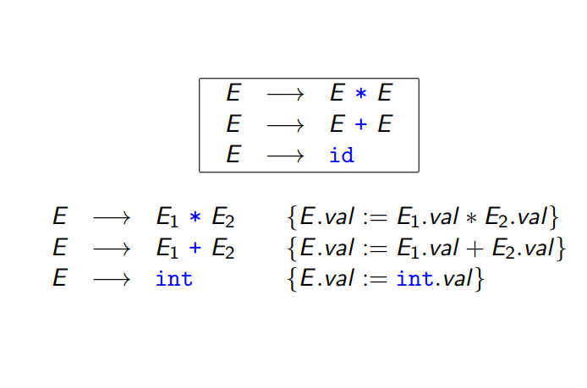
Example of Semantic Analysi

Slide 8
Syntax Directed Translation and Translation Scheme
When we associate semantic rules with productions, we use two notations:
Syntax-Directed Definitions
Translation Schemes
Syntax-Directed Definitions:
give high-level specifications for translations
hide many implementation details such as order of evaluation of semantic actions.
We associate a production rule with a set of semantic actions, and we do not say when they will be evaluated.
Syntax-Directed Translation Schemes:
indicate the order of evaluation of semantic actions associated with a production rule.
In other words, translation schemes give a little bit information about implementation details.

Slide 9
Syntax Directed Definition
SDD) is a context-free grammar together with, attributes (values) and rules (Semantic rules).
Attributes are associated with grammar symbols and rules are associated with productions.
If X is a symbol and a is one of its attributes, then we write X.a to denote the value of a at a particular parse-tree node labeled X.

Slide 10
Syntax Directed Definition
If we implement the nodes of the parse tree by records or objects, then the attributes of X can be implemented by data fields in the records that represent the nodes for X.
Attributes may be of any kind: numbers, types, table references, or strings, for instance.
The strings may even be long sequences of code, say code in the intermediate language used by a compiler.

Slide 11
Syntax Directed Definitions
Production Semantic Rules
L → E n print(E.val)
E → E₁ + T E.val = E₁.val + T.val
E → T E.val = T.val
T → T₁ * F T.val = T₁.val * F.val
T → F T.val = F.val
F → ( E ) F.val = E.val
F → digit F.val = digit.lexval

Slide 12
Attribute Grammar
So, a semantic rule b=f(c₁,c₂,…,c_{n}) indicates that the attribute b depends on attributes c₁,c₂,…,c_{n}.
In a syntax-directed definition, a semantic rule may just evaluate a value of an attribute or it may have some side effects such as printing values.
An attribute grammar is a syntax-directed definition in which the functions in the semantic rules cannot have side effects (they can only evaluate values of attributes).

Slide 13
Syntax Directed Translation
A syntax-directed definition is a generalization of a context-free grammar in which:
Each grammar symbol is associated with a set of attributes.
This set of attributes for a grammar symbol is partitioned into two subsets called
synthesized and
inherited attributes of that grammar symbol.
Each production rule is associated with a set of semantic rules.
The value of an attribute at a parse tree node is defined by the semantic rule associated with a production at that node.
The value of a synthesized attribute at a node is computed from the values of attributes at the children in that node of the parse tree
The value of an inherited attribute at a node is computed from the values of attributes at the siblings and parent of that node of the parse tree

Slide 14
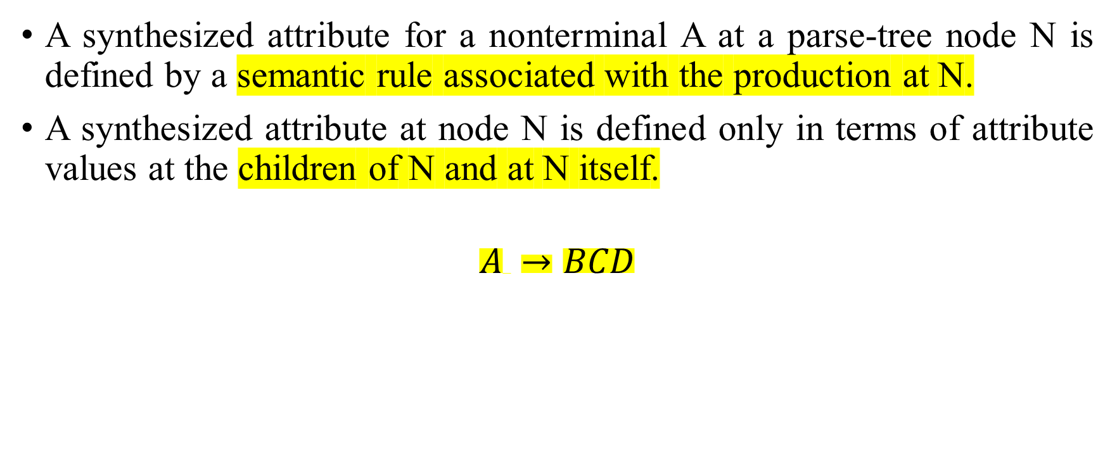
Synthesized Attribute
A synthesized attribute for a nonterminal A at a parse-tree node N is defined by a semantic rule associated with the production at N.
A synthesized attribute at node N is defined only in terms of attribute values at the children of N and at N itself.
$$A →BCD$$
A
B
C
D

Slide 15
Synthesized Attribute
The Parent node get the value from the child node
A.val = B.val
A.val = C.val
A.val = D.val
A
B
C
D

Slide 16
Inherited Attributes
An inherited attribute for a nonterminal B at a parse-tree node N is defined by a semantic rule associated with the production at the parent of N.
An inherited attribute at node N is defined only in terms of attribute values at N's parent, N itself, and N's siblings

Slide 17
Inherited Attributes
Value of node can be assign by Parent and its siblings both.
C.val = A.val
C.val = B.val
C.val = D.val
A
B
C
D

Slide 18
Annotated Parse Tree
A parse tree showing the values of attributes at each node is called an annotated parse tree.
2. Values of Attributes in nodes of annotated parse-tree are either,
initialized to constant values or by the lexical analyzer.
determined by the semantic-rules.
3. The process of computing the attributes values at the nodes is called annotating (or decorating) of the parse tree.
4. Of course, the order of these computations depends on the dependency graph induced by the semantic rules.

Slide 19
Syntax Directed Definitions
Production Semantic Rules
L → E n print(E.val)
E → E₁ + T E.val = E₁.val + T.val
E → T E.val = T.val
T → T₁ * F T.val = T₁.val * F.val
T → F T.val = F.val
F → ( E ) F.val = E.val
F → digit F.val = digit.lexval

Slide 20
Example: Annotated Parse Tree = 3 * 5 + 4n
Annotated Parse Tree = 3 * 5 + 4n
Make the syntax tree by using bottom up approach.

Slide 21
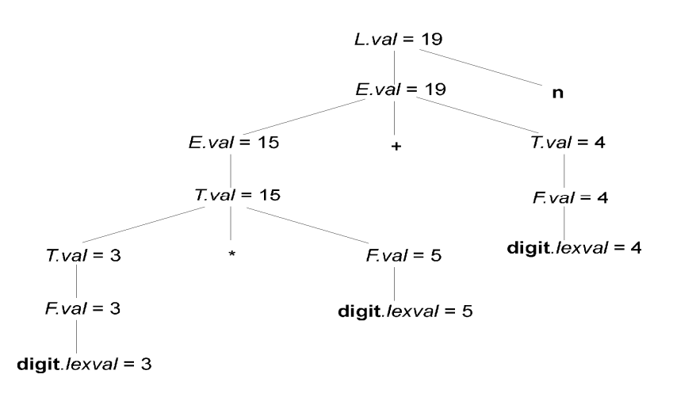
Solution:

Slide 22
Example: Annotated Parse Tree (3 + 4) *(5 + 6)n
Annotated Parse Tree = (3 + 4) *(5 + 6)n
Make the syntax tree by using bottom up approach.

Slide 23
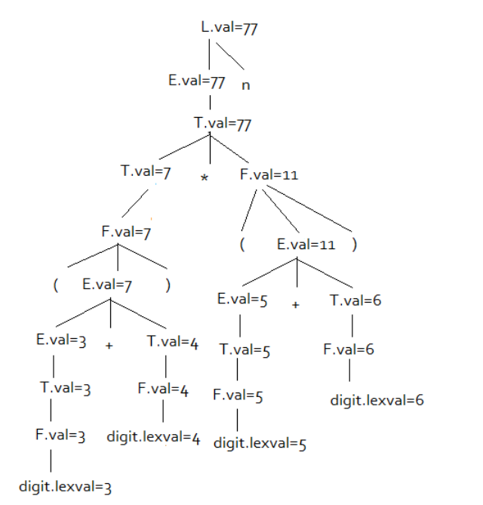
Solution:

Slide 24
Dependency Graph
A dependency graph characterizes the possible order in which we can evaluate the attributes at various nodes of a parse tree.
If there is an edge from node M to N, then attribute corresponding to M first be evaluated before evaluating N.

Slide 25
Dependency Graph
Input: 5+3*4
L
E.val=17 n
E.val=5 + T.val=12
T.val=5 T.val=3 * F.val=4
F.val=5 F.val=3 digit.lexval=4
digit.lexval=5 digit.lexval=3

Slide 26
Types of SDD
There are two types of SDD
S-Attributed Grammar
Synthesized Attributes which is also Known as S-Attributed Grammar.
L-Attributed Grammar
A SDD that uses both synthesized and inherited attributes, then such grammar is known as L-attributed Grammar,
Each inherited attribute is restricted to inherited from parent or left sibling only.

Slide 27
Attribute Flow
S-attributed grammar
Uses only synthesized types
Bottom-up attribute flow
L-attributed grammar
Attributes can be evaluated in a single left-to-right pass over the input
Each synthesized attribute of LHS depends only on that symbol’s own inherited attributes or on attributes (synthesized or inherited) of the production’s RHS symbols
Top down Parser

Slide 28
Inherited Attributes
Production Semantic Rules
D → T L L.in = T.type
T → int T.type = integer
T → real T.type = real
L → L₁ id L₁.in = L.in, addtype(id.entry,L.in)
L → id addtype(id.entry,L.in)
Symbol T is associated with a synthesized attribute type.
Symbol L is associated with an inherited attribute in.

Slide 29

Example 3:
Convert the given grammar into the Attributed grammar then make the annotated parse tree for 3*5,
CFG:
$T →FT$
$T` →∗FT_{1}`$
$T`→ ∈$
$F →digit$

Slide 30
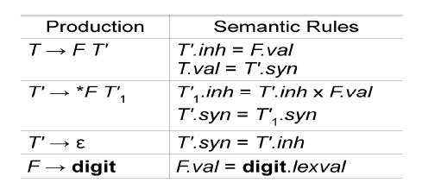
Solution: Semantic Rules

Slide 31
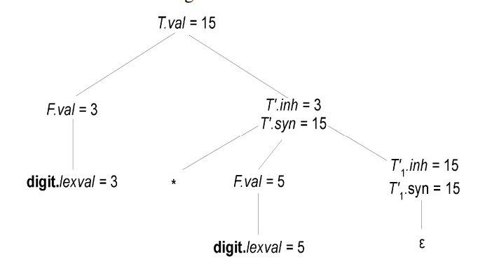
Solution: Annotated Syntax Tree

